Slide 1
Lung cancer Detection using machine learning for Histopatholgy Images
Supervisor : Dr.Gulistan Raja

Slide 2




Our team
Azib
Sabahat
Irtaza
Javeria
18-EE-43
Project Lead
18-EE-01
18-EE-46
18-EE-53

Slide 3
Table of contents
03
01
02
Introduction
Statement
Literature
04
05
06
Methodology
Analysis & Results
Schedule, Ethics & Budget
Lung cancer and it’s types
Histopathology Images
Background
Aim and Objectives
Conventional Method
Modern approaches and DL
Theoretical Studies
Experimental Setup
Analysis metrics
Results and Society
Work Schedule, Ethics and budget
References

Slide 4
01
Introduction
Javeria Noor
18-EE-53

Slide 5
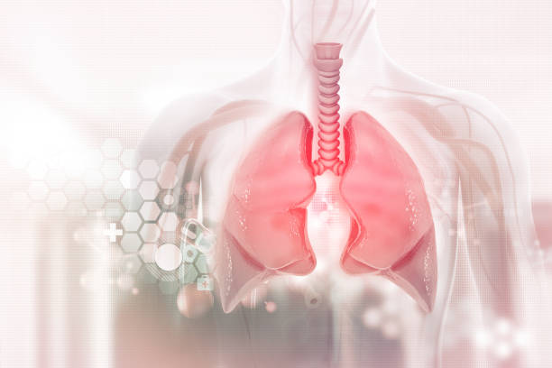
Lung cancer & Types
Lung cancer is deadliest cause of death among individuals. Biggest cause of lung cancer is smoking.
Non-Small Cell Lung Cancer (NSCLC)
Squamous cell carcinoma
Adenocarcinoma
Large cell carcinoma
Small Cell Lung Cancer (SCLC)
Small Cell Carcinoma
Combined Small Cell Carcinoma

Slide 6
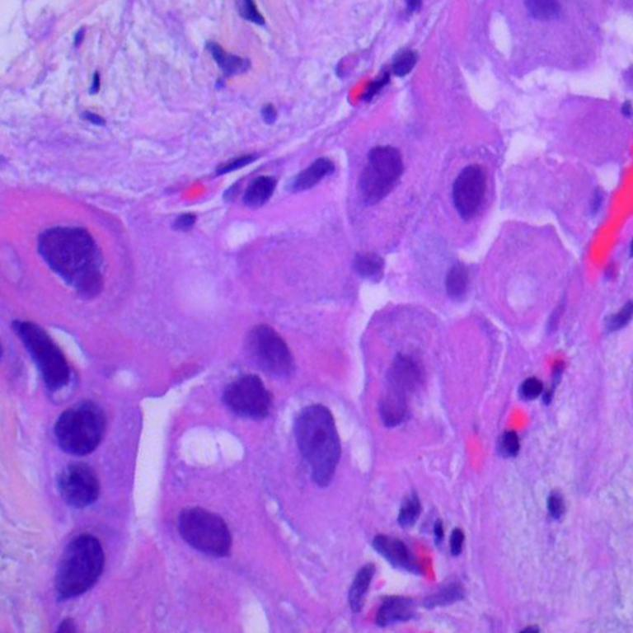
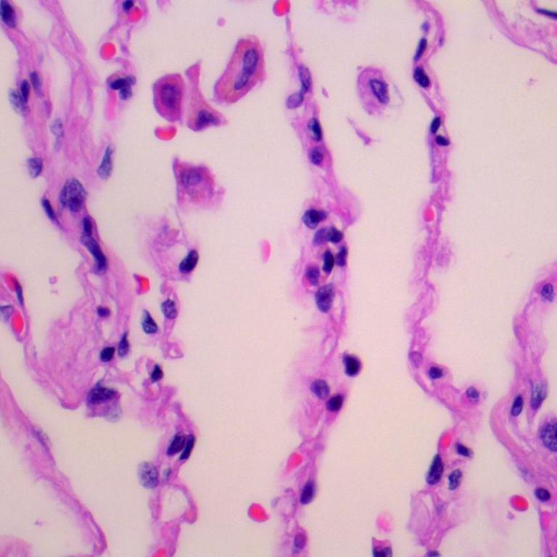
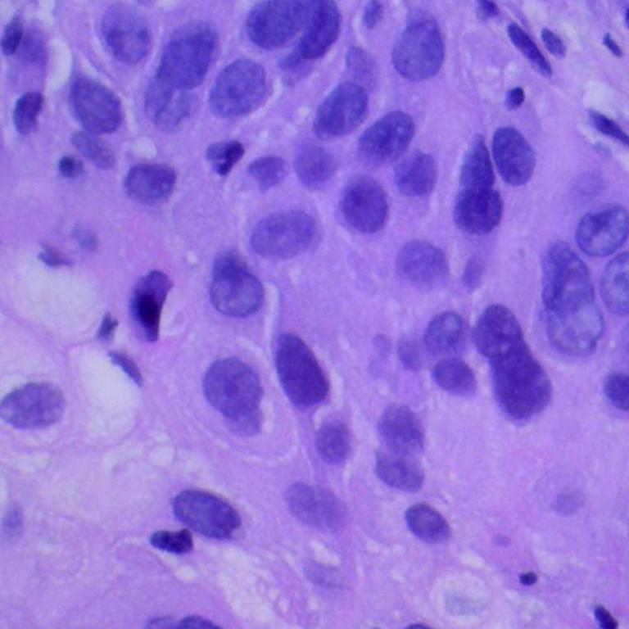
Histopathological Images
Microscopic digital image of tissue sample obtained through biopsy.
Used in Cancer Diagnostics.
Whole slide enriched in digital information.

Slide 7
02
Problem Statement
Sabahat Tabassum
18-EE-01

Slide 8
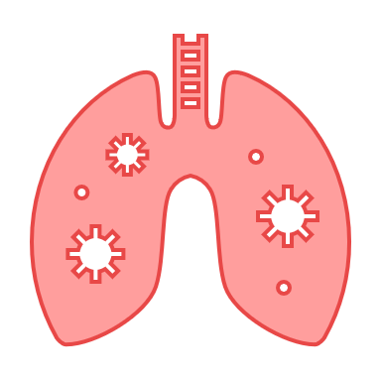

BACKGROUND
14% diagnosis
28% deaths

Slide 9
Problem Statement is:
The Detection of lung cancer at the early stages is troublesome for histologists which makes the reports vulnerable to human error leading to deaths.

Slide 10
AIM
Automated detection of lung cancer, identify its type and obtain acceptable accuracy.

Slide 11




OBJECTIVES
Detect lung cancer using deep learning approach
Identify Subtype
ACA, SCC, Ben
Validation
and
testing
Obtain
acceptable
accuracy

Slide 12
03
Literature
Syed Irtaza
18-EE-46

Slide 13
Literature Review
Conventional Method for Lung Cancer Detection
Imaging System : X-rays and CT scan are used to detect the abnormal cell growth in lungs.
Sputum Cytology: Sputum analyzed under microscope to confirm cancer.
Tissue Sample: Tissue cells are analyzed under microscope to confirm cancer. Different method being used for biopsy are Mediastinoscopy, Bronchoscopy, Needle Biopsy.

Slide 14
Literature Review
New methods for Lung cancer detection
Pathologist need lot of time to study pattern of tissue sample under microscope. To help pathologist Machine Learning Algorithm can be used for detection of the lung cancer. We reviewed the Deep Learning Models used for detection of lung cancer.

Slide 15
Literature Review
M. Saaric
T- Atushi (2017)
VGG16
Deep CCNN
Hatuwal (2020)
W. Auswalaithong (2018)
covNets
DenseNet-121
Histopathology image
Accuracy 75.41 %.
Cytology Images
Accuracy 71.1%
X-ray images
Accuracy 74.43 %
Histopathology image
Accuracy 97.2 %

Slide 16
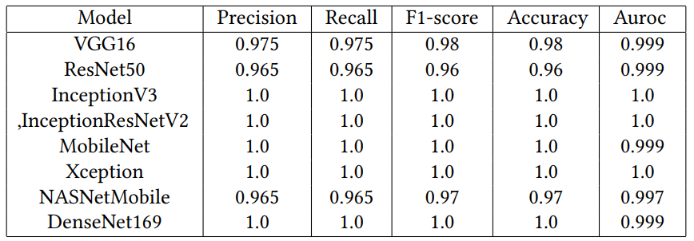
Literature Review
S. Garg ( 2021 )
Eight different model s
Histopathology Images
Acuracy: 96-100%

Slide 17
04
Methodology
Azib Farooq
18-EE-43

Slide 18
Tools
Language
Dataset
Hardware
Following tools are fundamental to our project
Python is used for
programming and
development purposes
LC25000 dataset is used for training and validation purposes.
Google Colab is the prime priority for training and testing the model.

Slide 19
Theoretical Studies
Deep Learning
Transfer Learning
Pre-trained Models
CNNs
RNNs
Feature Extraction
Weight Transfer
ImageNet
ResNet

Slide 20
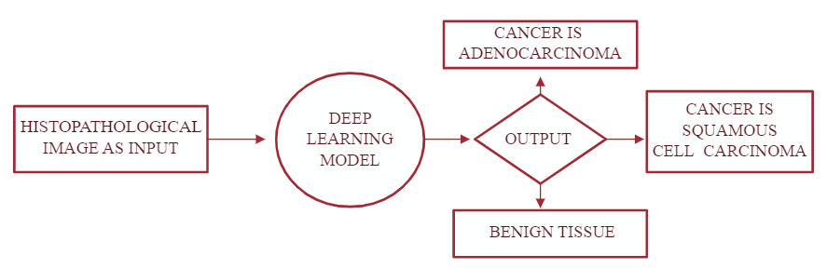
High Level Block Diagram

Slide 21
Deep Learning Model Internal Block Diagram
Augmentation
Data Preprocessing
Training
Validation
Modelling
TL (ResNet50)
Fine
Tuning
Modifying Network
Optimization
Metrics
Precision
Accuracy
F1Score
Recall

Slide 22
Experimental Setup
Data
Pre-processing
Modelling
Data Augmentation
Data Split
Fine Tuning
Modify CNN
Optimization

Slide 23
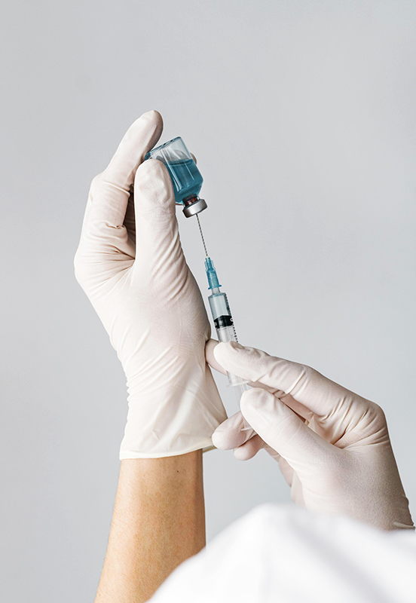
Data Preprocessing
Data
Augmentation
Data
Split
Original samples : 750
Final samples : 15000
Augmentation : 1/20
Training : 12000
4000 per class
Validation : 3000
1000 per class

Slide 24
Modelling
Fine Tuning
Modifying CNN
Optimization
Residual Network (ResNet50)
Setting Hyperparameters
Freezing hidden layers
Freezing weights
Removing Last layer
Adding 3 neuron Dense layer with sigmoid activation
Adam optimizer is used for compiling model with different hyperparameters.

Slide 25
05
Analysis & Results
Azib Farooq
18-EE-43

Slide 26


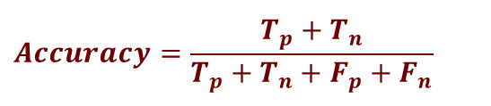
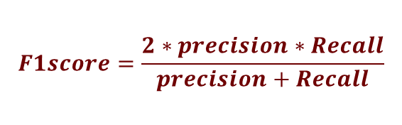

Analysis Metrics
Precision
Accuracy
F1score
Recall
$$T_{p}=True Positive;T_{n}=True Negative;$$
$$F_{p}=False Positive;F_{n}=False Negative$$
$$Accuracy=\frac{T_{p}+T_{n}}{T_{p}+T_{n}+F_{p}+F_{n}}$$
$$precison=\frac{T_{p}}{T_{p}+F_{p}}$$
$$F1score=\frac{2∗precision∗Recall}{precision+Recall}$$
$$Recall=\frac{T_{p}}{T_{p}+F_{n}}$$

Slide 27
Result & Society
Classification
Reduce Burden
Visibility
Speed
The model is expected to achieve acceptable accuracy on all metrics.
Following the anticipated benefits of our model.
Classifying lung cancer
patients as low and high
risk.
Assist histologists to
focus high risk patients.
Give more visibility of the
area of interest in
histopathological images.
Faster and better treatment and swift prescription.

Slide 28

06
Supplements
Javeria Noor
18-EE-53

Slide 29


Work Schedule Plan
Activity | Time Schedule
Collection of Literature | Dec 13 – Dec 25 2021
Study of Literature | Dec 25 – Jan 8 2021
Analysis of Proposed Scheme | Jan 8 – Jan 26 2021
Preparation of Schemes / Model | Feb 08 – Feb 27 2021
Implementation of Schemes/Model | Feb 28 – March 27 2021
Analysis & Simulation | March 27 – April 17 2021
Result Formulation | April 18 - May 1 2021
Final Write-up & Thesis Submission | May 2 – May 15 2021

Slide 30

Ethics
MEDICAL ETHICS
ENGINEERING ETHICS
Moral principles
Avoid Deceptive acts
Safety, Health and welfare
Professionalism
Autonomy
Beneficence
Confidentionality
Non-Malificence
Justice and Equity

Slide 31


BUDGET DESCRIPTION
Dedicated hardware is required to be purchased for training of the model, namely abbreviated as GPU.
Name | Price | Memory | Time
Google Colab | Free | 6GB | 6 hours
Kaggle | Free | 40GB | N/A
Nvidia A100 | $0.80/month | 8GB | N/A
Colab Pro | $9.99/month | 12GB | 6 hours
AMD RX 6800 | $850 | 4GB | N/A

Slide 32
Thank You

